Slide 1
Voice Interview Utility
How I built a real AI-powered tool in a morning with Claude Code
A companion to the blog post | April 2026 | Read the post
Jared Grant | jaredmgrant.com

Slide 2
The Problem
Why I built this instead of buying something off the shelf
The Friction
The Insight
A friend recommended dictation for on-the-go productivity — knocking out docs, frameworks, and content.
I tried it. I felt absolutely ridiculous talking to my computer like I was talking into the ether. My language was disjointed. It didn't make sense.
I regularly produce documentation, write content, and have ideas worth capturing — the problem was never a shortage of ideas. It was getting them out efficiently.
What if it was more conversational? What if I gave it a topic and it prodded me — recording my answers as we go?
What I Actually Wanted
Work on the go from my phone
Auto-clean transcripts — no manual copy-paste
Generate structured content from my own words
Build something I could own and extend

Slide 3
What I Built
Three modes, one LAN-hosted utility, zero ongoing hosting cost
Content Interview
Practice Interview
Collaborative Edit
Describe a topic. Claude derives themes, sets a brief, and conducts a structured voice interview.
Synthesizes transcript into summary, content angles, and a full blog draft using near-verbatim language.
Auto-analyzes draft for gaps and runs targeted follow-up questions to fill them.
Paste a job description. Claude simulates a realistic hiring manager interview.
Debrief includes strengths, weaknesses, improvement tips, and sample answers.
Useful for interview prep and team training.
Upload an existing document — draft, outline, prior session JSON, PDF, or DOCX.
Claude identifies where content is thin, conducts a targeted voice interview to fill gaps.
Generates an enhanced version incorporating your answers. Exports as .docx.
All modes: voice input via Web Speech API · text fallback for unsupported browsers · sessions auto-saved as JSON + Markdown

Slide 4
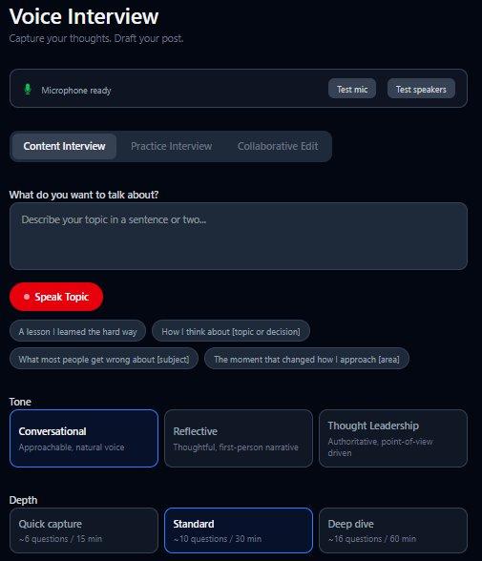
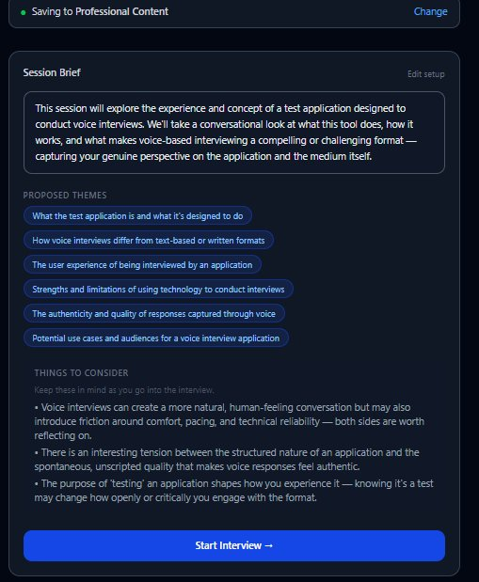
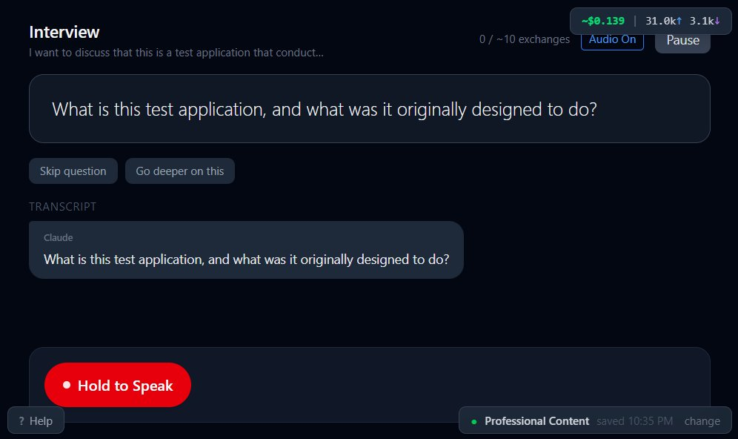
The Interface
Three screens from setup to live interview
Setup — topic, tone, depth
Brief — themes, things to consider
Interview — live questions, transcript

Slide 5
Tech Stack
Everything we (Claude Code and I) selected, configured, and wired together
React 19 + Vite
mkcert
SPA, client-side rendered
Locally-trusted HTTPS for LAN mic access
Tailwind CSS v4
docx + pdfjs + mammoth
Utility-first styling
DOCX export, PDF/DOCX source parsing
Web Speech API
Node.js LTS / Windows 11
Browser-native STT — no third-party service
Host: GMKtec mini PC
@anthropic-ai/sdk
Windows Task Scheduler
Direct browser API calls to Claude Sonnet 4.6
Auto-start on boot, SYSTEM account, no login
Express 4
claude-sonnet-4-6
Production server + /api/save endpoint
Primary model · claude-haiku-4-5 for answer eval

Slide 6
Building with Claude Code
The AI wrote the code. I decided what mattered.
1. Describe
→
2. Generate
→
3. Test
→
4. Refine
Plain-language problem statement in Claude UI or console
Claude writes component, fix, or full feature
Run in browser, check behavior across devices
Describe the delta in natural language, repeat
What the AI did well
Where human judgment was irreplaceable
Held full codebase context across every session
Reasoned through browser API specs during debugging
Consistent code style, file structure, and naming
Fast iteration on UI layout, copy, and error states
Produced install + update scripts autonomously
Deciding which features actually mattered
Recognizing when a fix out output was wrong despite passing tests
LAN vs cloud architecture decisions
Knowing which new features were worth it
Cost Control/Balancing
Describing symptoms precisely enough to diagnose bugs

Slide 7
The Hard Part: Mobile Voice Recognition
A debugging story that shows what AI-assisted development actually looks like
The Bug
The Fix
Mobile Chrome Web Speech API returns results cumulatively:
Result[0] = "I"
Result[1] = "I just"
Result[2] = "I just wanted to say"
Each new recognition event re-states all previous words. Naive concatenation produces duplicated text. Audio replay on recognizer restart added a second duplication vector.
Detect cumulative behavior: check if the latest final result starts with the previous final result.
If yes: treat only the latest as the full session text.
If no: concatenate distinct phrases normally.
Restart boundary: use whichever is longer — new session text or accumulated text — to handle audio replay.
4 iterations across sessions to reach a stable solution. Debugging approach: explain symptoms first, no code changes, isolate hardware vs software vs API.
The AI held full technical context across the entire debugging conversation. That is not something a search engine does.

Slide 8
Deployment Architecture
GMKtec mini PC on the home LAN. Always-on. Zero hosting cost.
Devices
GMKtec Mini PC
Anthropic API
Laptop
Node.js / Express server
Serves dist/ (React SPA)
/api/save endpoint
sessions/ backup folder
HTTPS via mkcert certs
Auto-start: Task Scheduler (SYSTEM, no login)
claude-sonnet-4-6
claude-haiku-4-5
Direct browser calls
Per-session cost tracking
→
Mobile
→
→
HTTPS :4173
LAN WiFi
API calls
Tablet
→
Setup: one script, one question
setup.bat → setup.ps1: installs Node.js + mkcert, copies files, prompts for API key, builds, opens firewall, registers scheduled task. update.bat: stops service, copies new files, rebuilds, restarts. Portable and consistent across environments

Slide 9
The Reframe
What this project revealed about where value actually lives on analytics teams
Capabilities are all accessible
Consumer vs. Creator
What analytics hiring looks like now
Code can be generated to do what you can imagine. It's more important to have the imagination on your team than to have the software and specific coding skills that performs the task.
Everyone consumes AI — LLMs, copilots, ChatGPT. The value distinction is in using AI to build actual resources. Things that do other things.
Less about code experts. More about abstract thinking, problem translation, and the organizational understanding to deploy outcomes that actually stick.
“Anyone can create capabilities — anyone at all — using natural language and a tool like Claude Code. Historically that has been the biggest challenge. Today that's the easy part.”

Slide 10
"I started the day with a problem, an idea, no code base, and had a solution by the end of the morning."
The differentiator is no longer who can write the most elegant code.
It's who can recognize what's worth building, guide AI-assisted execution,
and ensure the result fits the organization it's meant to serve.
The question for analytics leaders is not whether these capabilities are real.
The question is what your team is choosing to imagine.

